Slide 1
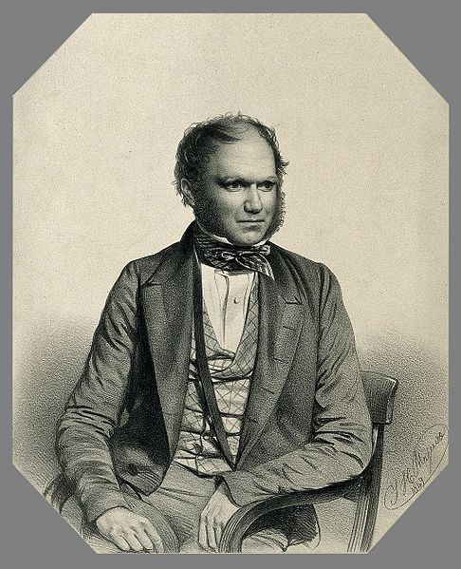
Hacking Darwin

Slide 2
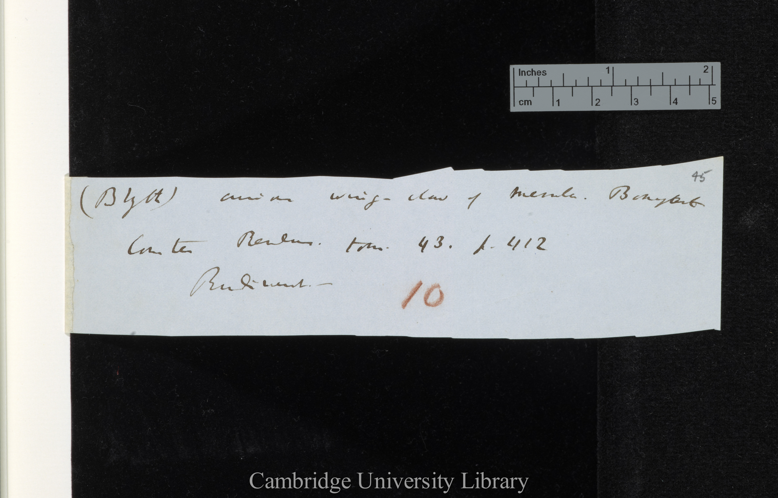
saw-tooth edgege
Notes:
DAR 205.1: 45 saw toothed

Slide 3
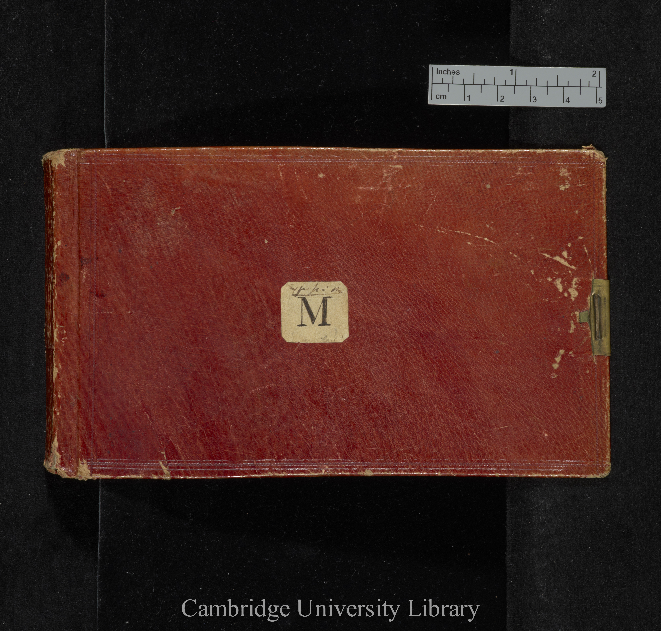
Notebook M

Slide 4
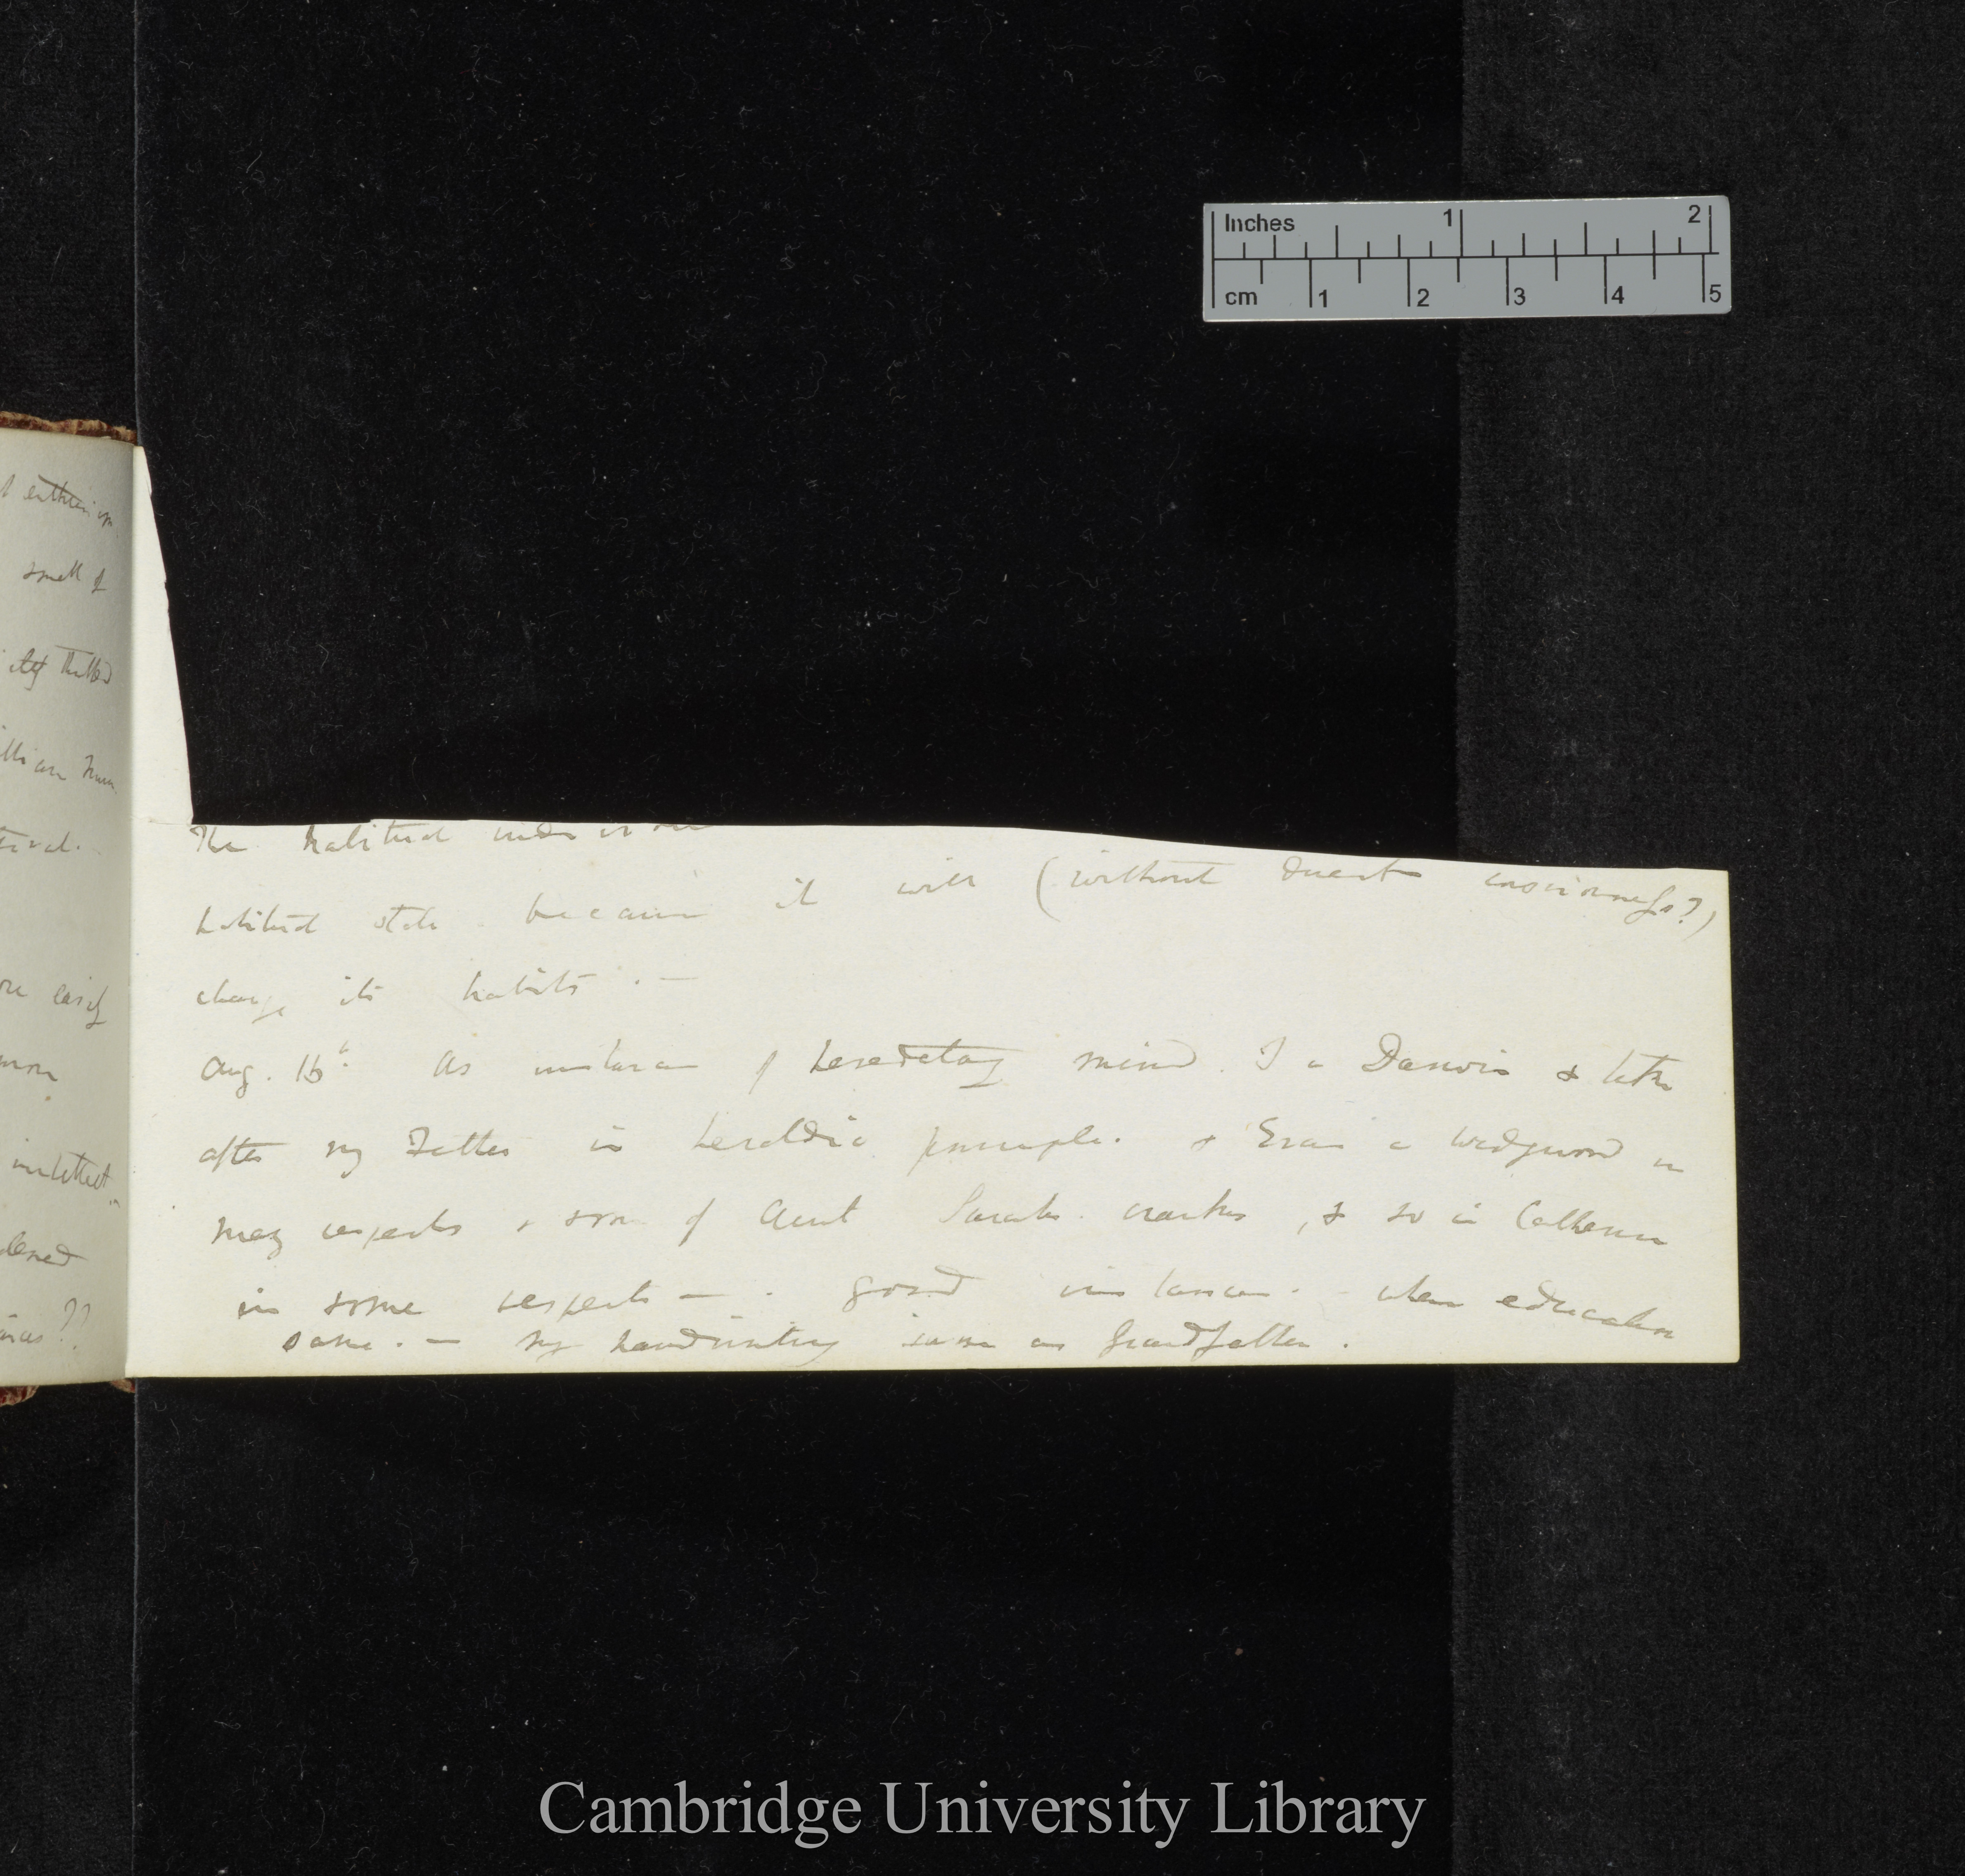
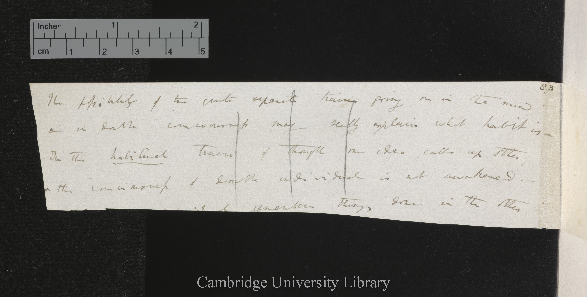
Two matching pieces
Loose note DAR 53.1
Metaphysical Notebook M

Slide 5
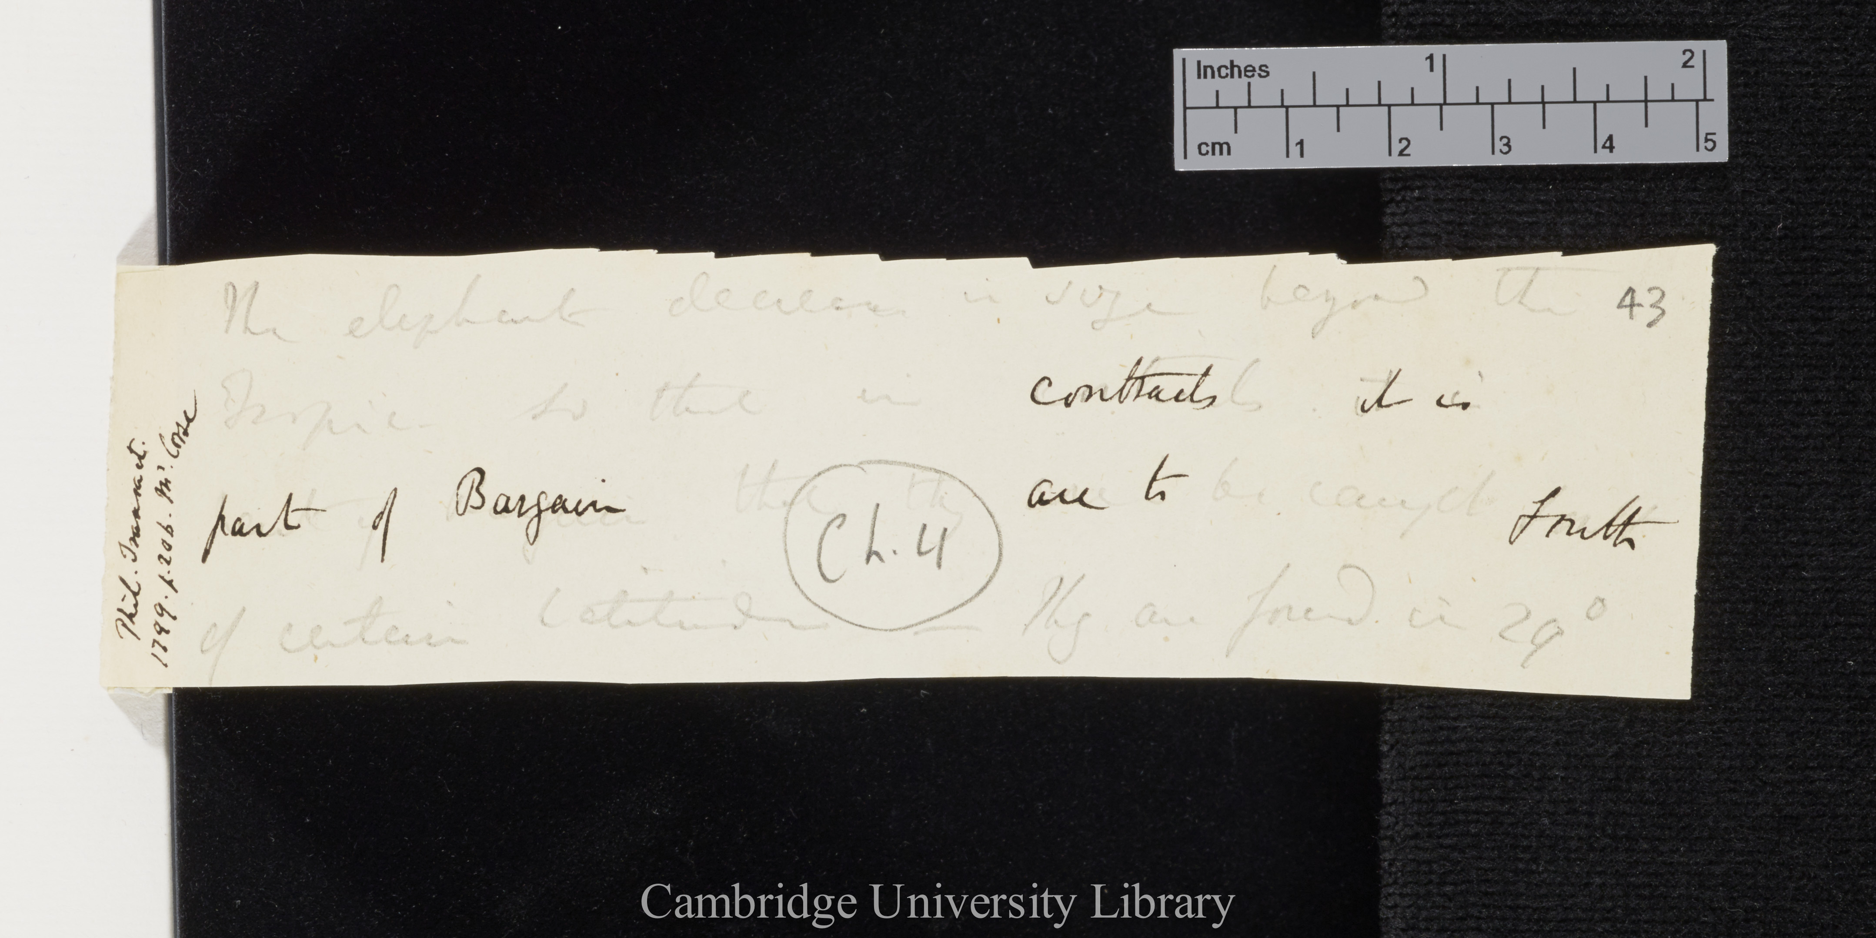
saw-tooth edgege
DAR 45: 43

Slide 6
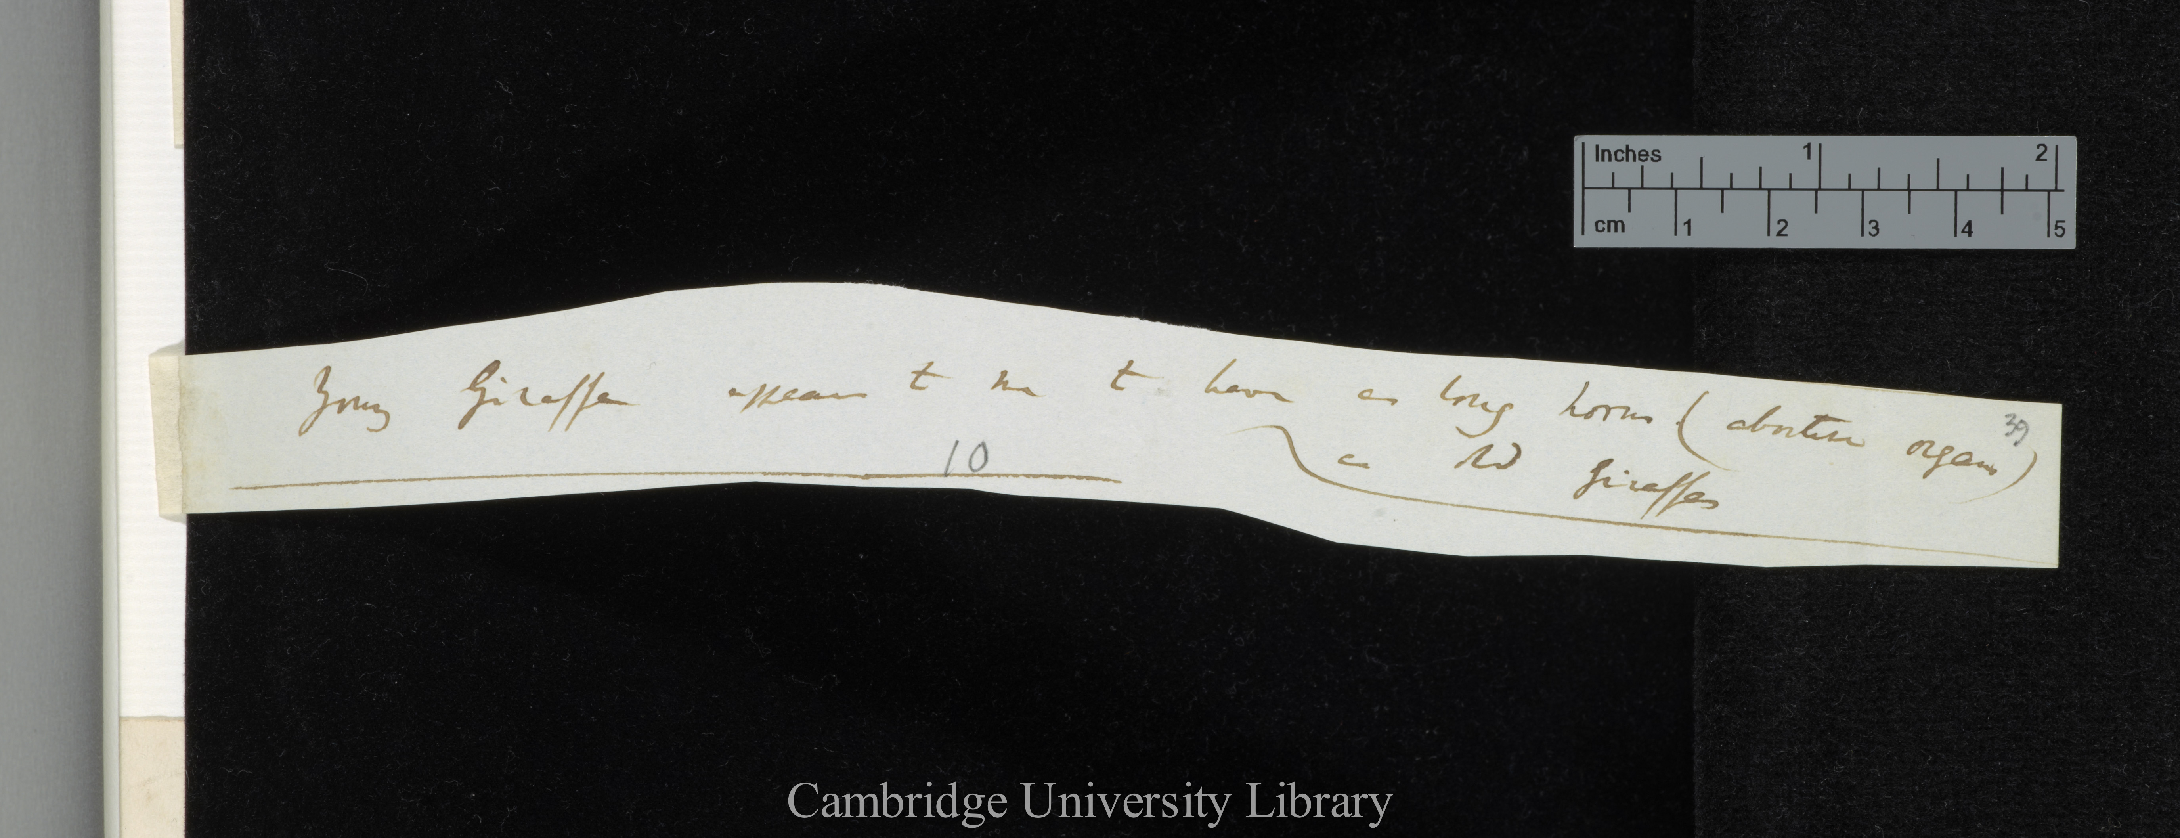
curved cut edge
DAR 205.1: 39

Slide 7
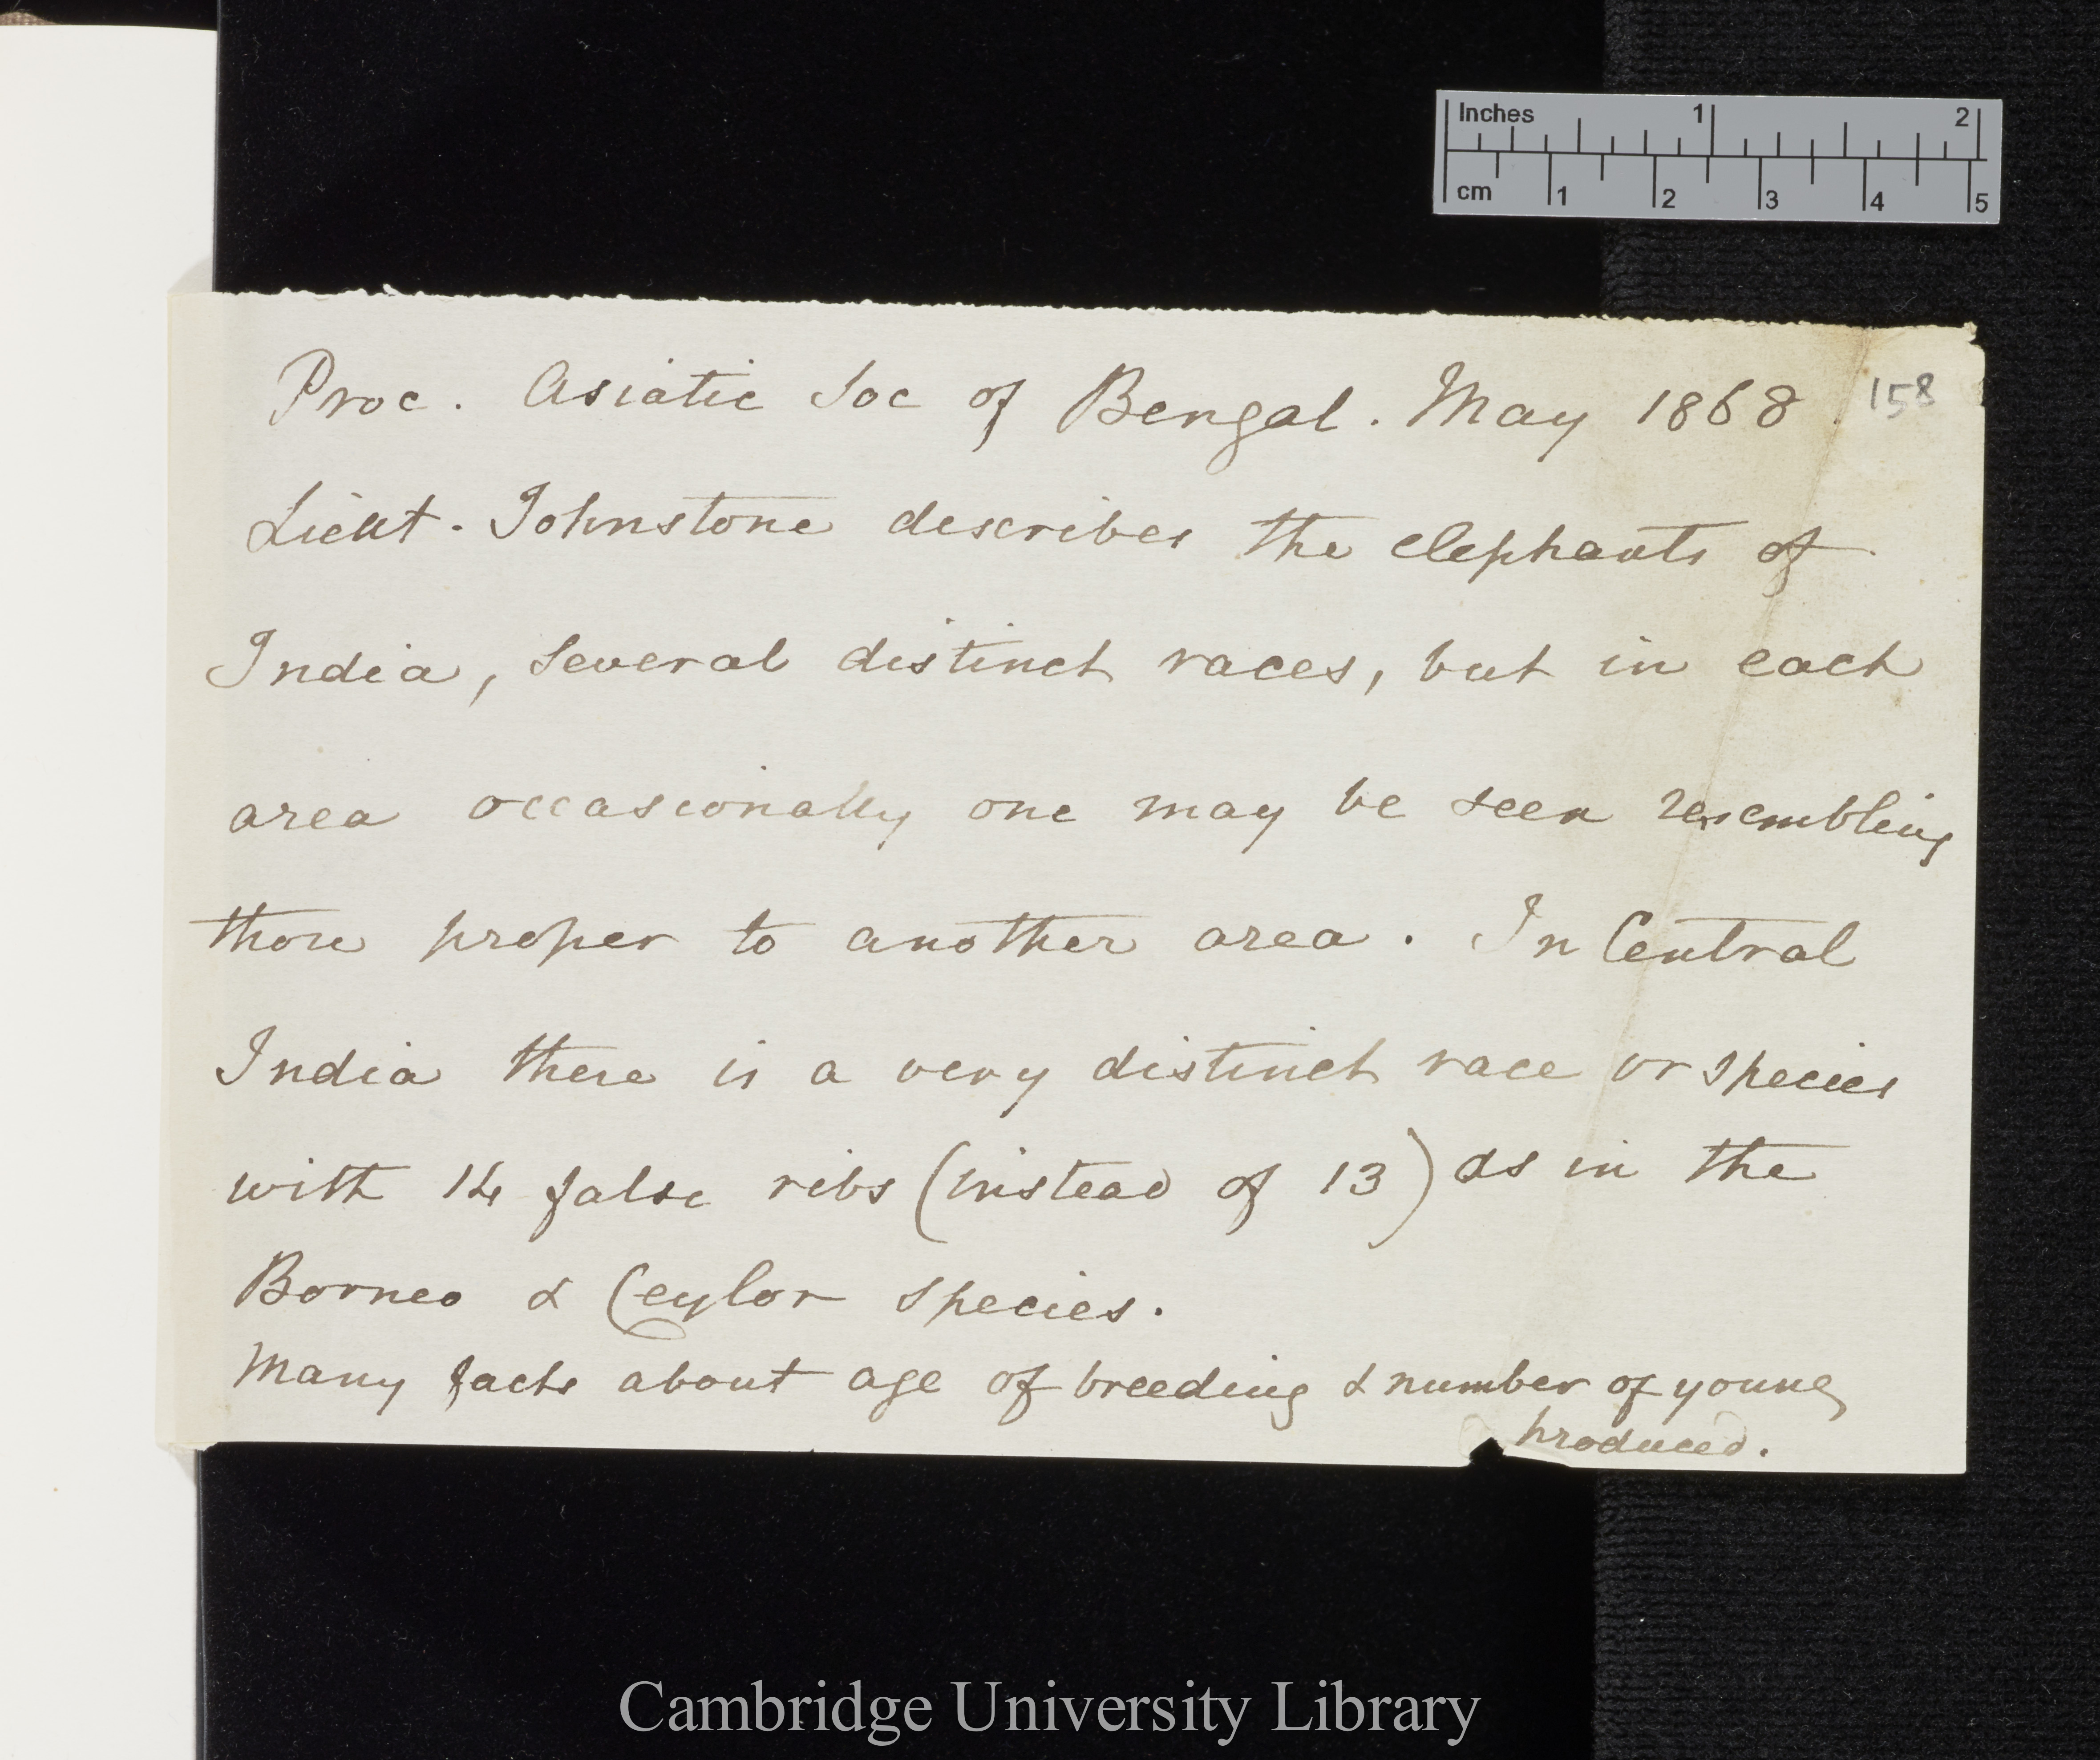
fuzzy edge
tear
DAR 45: 158
DAR 45: 158

Slide 8
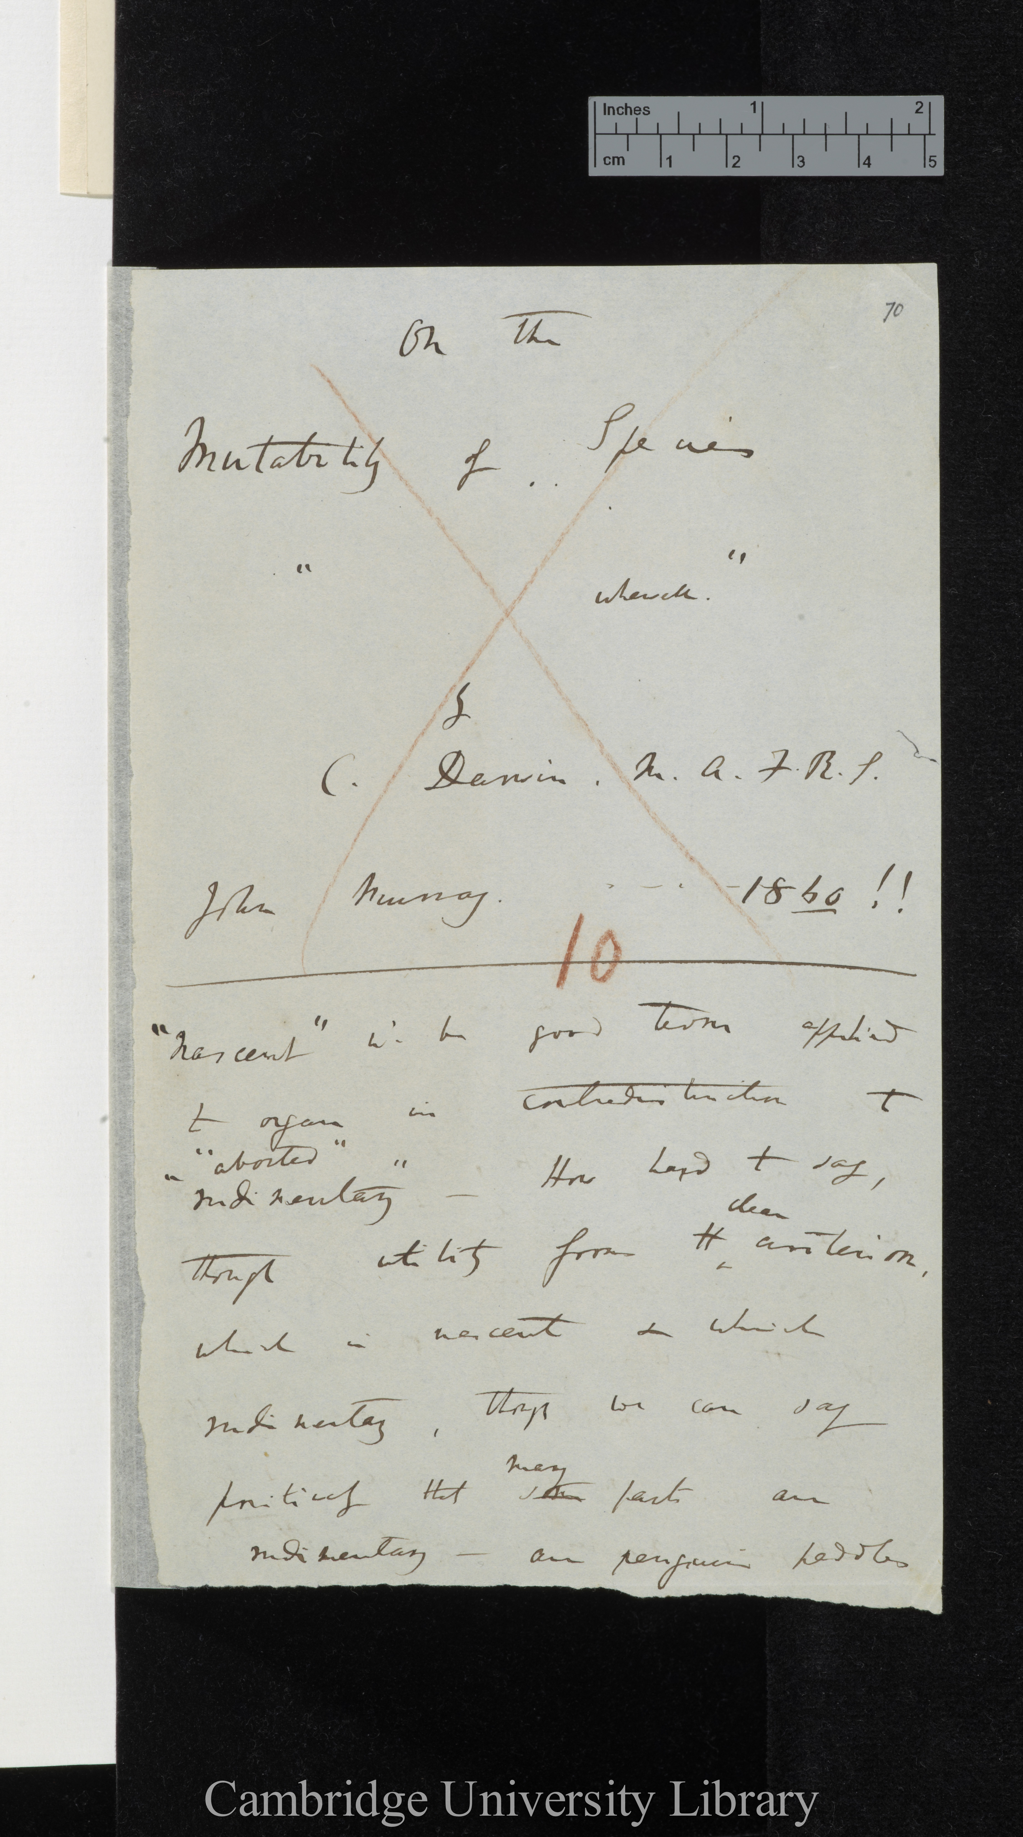
DAR 205.1: 70
fuzzy edge
irregular shape
fuzzy edge detail

Slide 9
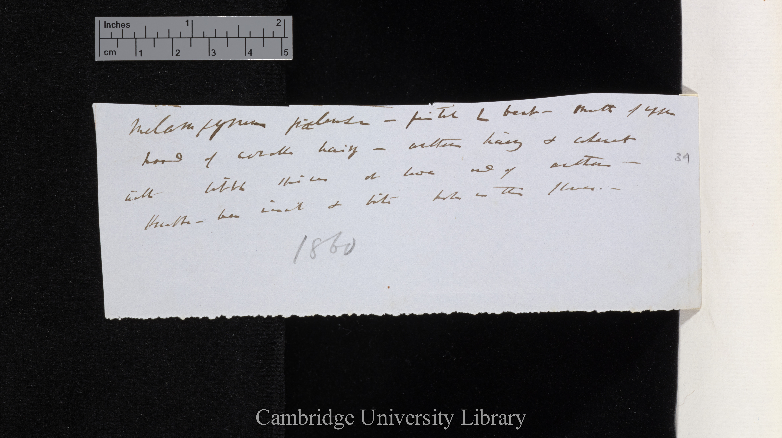
very fuzzy edge

